Slide 1
Knuth-Morris-Pratt (KMP)Algorithm
TEAM MEMBERS:
ABDULLAH
MUSTUFA
ABDUL QUDOOS

Slide 2
KMP ALGORITHM
Knuth-Morris and Pratt introduce
linear time algorithm for the string matching problem.
matching time of O (n) is achieved by avoiding comparison with an element of 'S' that have previously been involved in comparison with some element of the pattern 'p' to be matched.

Slide 3
COMPONENTS OF KMP ALGORITHM
Prefix Function
KMP Matcher

Slide 4
PREFIX FUNCTION
The Prefix Function (Π):
Π for a pattern encapsulates knowledge
how the pattern matches against the shift of itself.
This information used to avoid a useless shift of the pattern 'p.'

Slide 5
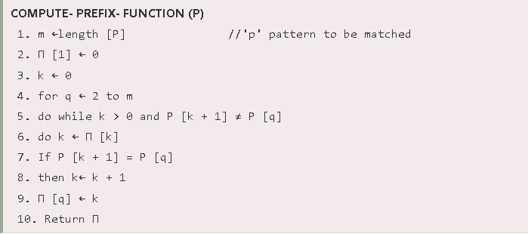
PREFIX FUNCTION

Slide 6
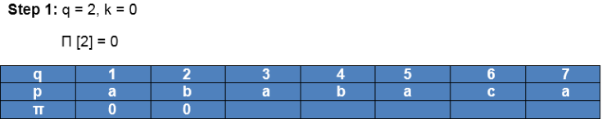
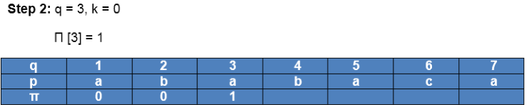
PREFIX FUNCTION

Slide 7
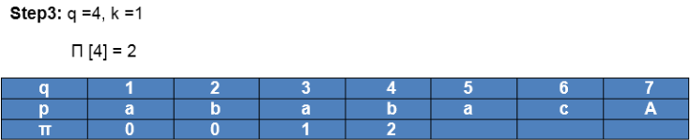
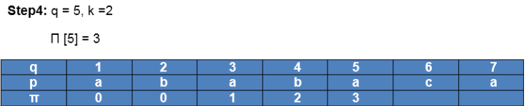
PREFIX FUNCTION

Slide 8
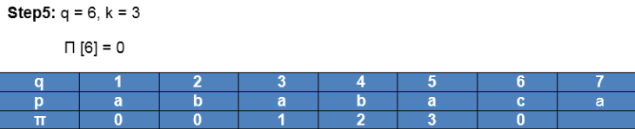
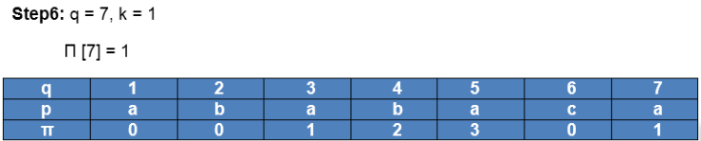
PREFIX FUNCTION

Slide 9
PREFIX FUNCTION
Computation Complete

Slide 10
KMP MATCHER
The KMP Matcher with the pattern 'p,' the string 'S' and prefix function 'Π' as input, finds a match of p in S

Slide 11
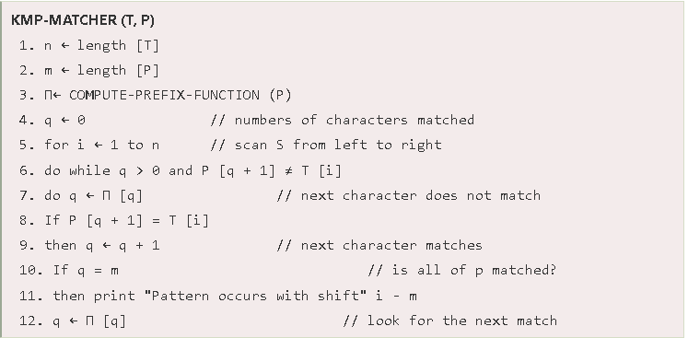
KMP MATCHER

Slide 12
KMP MATCHER
'p' the prefix function was computed previously and is as following;

Slide 13
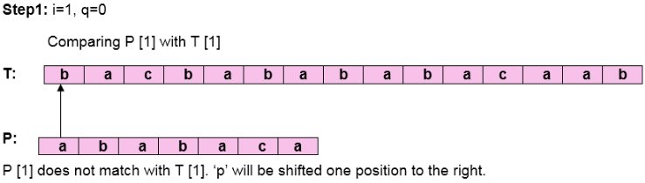
KMP MATCHER

Slide 14
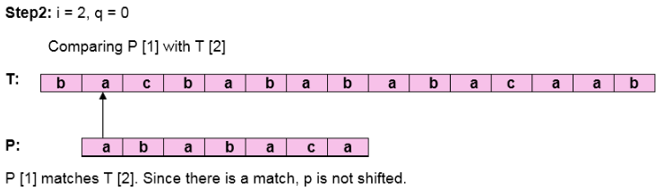
KMP MATCHER

Slide 15
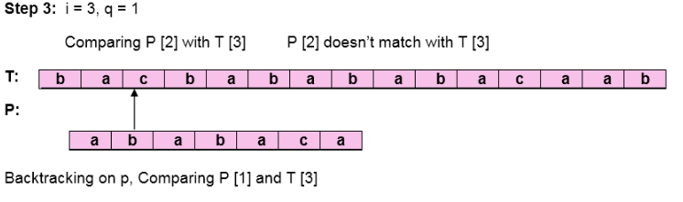
KMP MATCHER

Slide 16
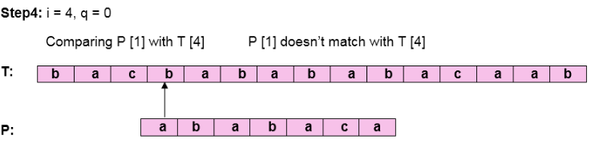
KMP MATCHER

Slide 17
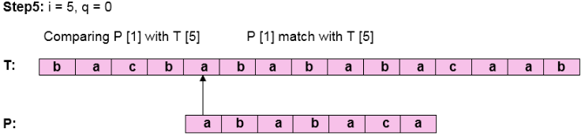
KMP MATCHER

Slide 18
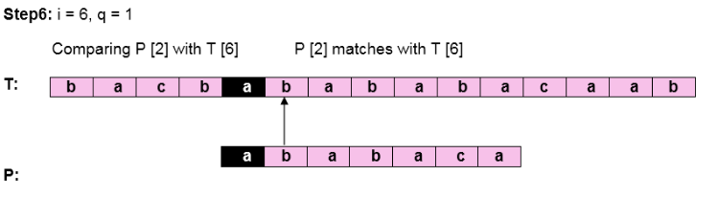
KMP MATCHER

Slide 19
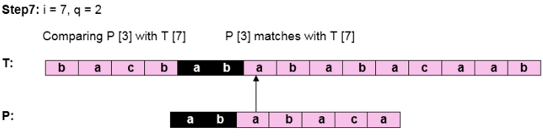
KMP MATCHER

Slide 20
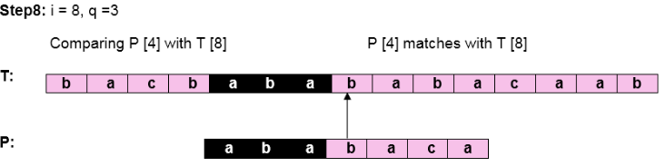
KMP MATCHER

Slide 21
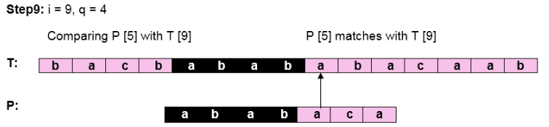
KMP MATCHER

Slide 22
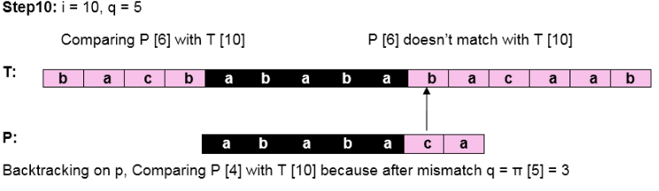
KMP MATCHER

Slide 23
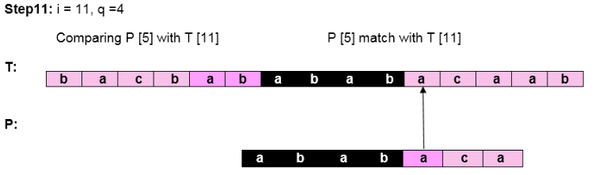
KMP MATCHER

Slide 24
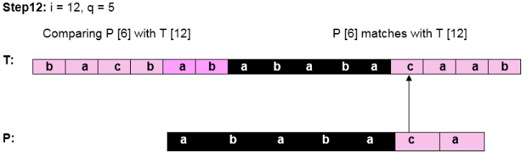
KMP MATCHER

Slide 25
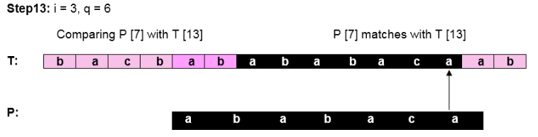
KMP MATCHER
Pattern 'P' has been found to complexity occur in a string 'T.'
The total number of shifts that took place for the match to be found is i-m = 13 - 7 = 6 shifts

Slide 26
APPLLICATIONS
Digital libraries
Screen scrapers
Word processors
Web search engines
Spam filters
Natural language processing

Slide 27
THE END

